Slide 1
NLP Review Analyzer
Luis Guimarães
Ironhack AI/ML Bootcamp
July 2025

Slide 2
Why This Matters
E-commerce stores are overwhelmed by customer reviews.
Manually reading reviews is time-consuming.
Can we automate insights from reviews using NLP?

Slide 3
Dataset Overview
Source: Amazon Reviews Dataset (Fashion category)
Initial size: 90,000 (11%) → Cleaned: 2,370 reviews
Fields used: reviewText, stars, product_title, category
reviews.json.gz: Reviews
metadata.json.gz: Product info

Slide 4
NLP Pipeline Overview
Preprocessing with Polars
Sentiment Classification (RoBERTa)
Product Clustering (MiniLM + KMeans)
Review Summarization (BART + GPT-3.5)

Slide 5
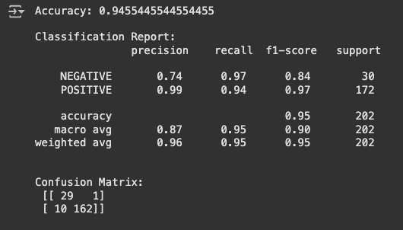
Sentiment Classification
Star ratings * mapped to sentiment labels (POS / NEG)
Accuracy: 94.5%
Evaluation: Confusion matrix + Precision/Recall

Slide 6
Product Clustering
Embeddings: MiniLM-L6-v2
Clustering: KMeans with 5 meta-categories
Notes:
2 meta-categories:
Functional/Comfort: Athletic, durable, weather-appropriate products
Stylish/Appearance-driven: Visual appeal, sizing issues, trendy/seasonal wear

Slide 7
Summarization with GPT
Summarized top positive and negative reviews
Extracted key strengths and complaints
Identified worst product per cluster and why to avoid

Slide 8
Sample Summary Output
✅ ASIN: B07YFK4MDD
Lightweight, waterproof, good for everyday use
⚠ Misleading sizing, poor quality materials
❌ Worst Product: House slippers (uncomfortable, cheap feel)

Slide 9
Final Takeaways
Automated insight extraction is feasible with pre-trained models.
Classification and clustering performed well with minimal tuning.
GPT helped convert raw text into valuable product summaries.

Slide 10
What’s Next?
Add UI
Explore other review sources

Slide 11

Questions

